Slide 1
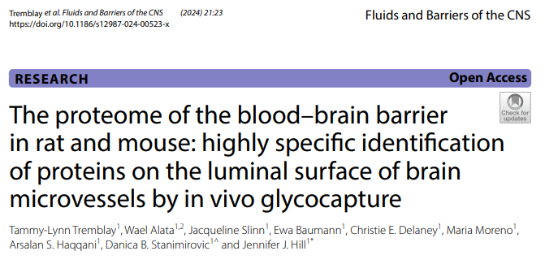
In vivo Glycocapture Paper Review (2024)

Slide 2
Background & Problem
Context: The Luminal BBB Surface contains receptors vital for RMT (Receptor-Mediated Transcytosis).
Problem: Profiling these proteins is difficult due to low abundance.
Limitation of previous methods: NHS-biotin labeling has low specificity (10-30%) in brain.
Hypothesis: The thick glycocalyx at the BBB limits NHS-ester accessibility.
Solution: Target glycans instead of amines.

Slide 3
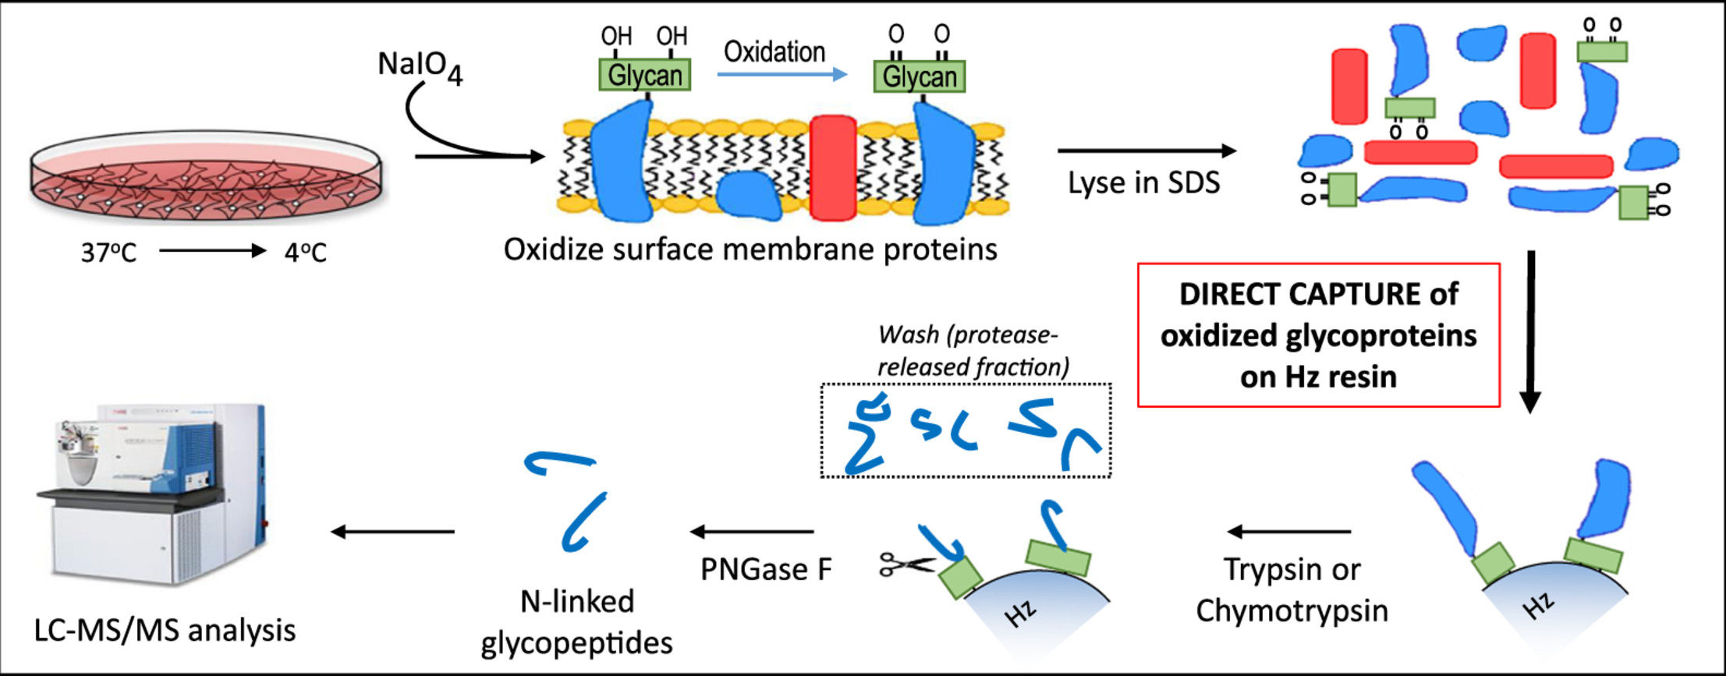
General Method: Glycocapture
1. Oxidation: Mild oxidation (NaIO4) converts cis-diols on glycans to aldehydes.
2. Capture and Release: Hz resin reacts with aldehydes; Specific release of N-linked glycopeptides using PNGaseF.
3. Analysis: LC-MS/MS identification.
PNGaseF deglycosylation causes a deamidation of the N-X-T motif (N to D), a chemical signature that can be used to specifically identify glycan captured-and-PNGaseF-released peptides
(Screening out non-specifically captured or released “junk”)

Slide 4
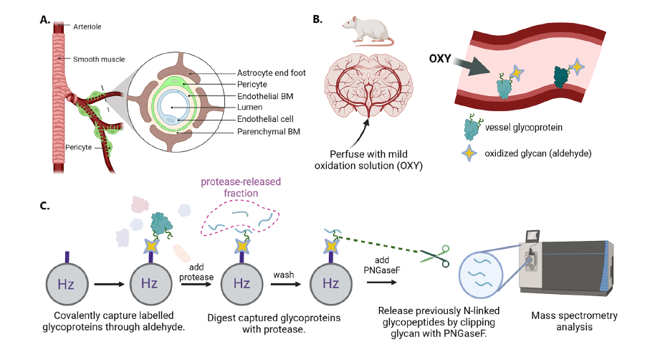
New method in this paper (2024): In Vivo Perfusion Glycocapture
1. Perfusion: Mild oxidation (NaIO4) converts cis-diols on glycans to aldehydes.
2. Capture: Vessel enrichment via filtration, followed by covalent capture on hydrazide beads.
3. Release: Specific release of N-linked glycopeptides using PNGaseF.
4. Analysis: LC-MS/MS identification.

Slide 5
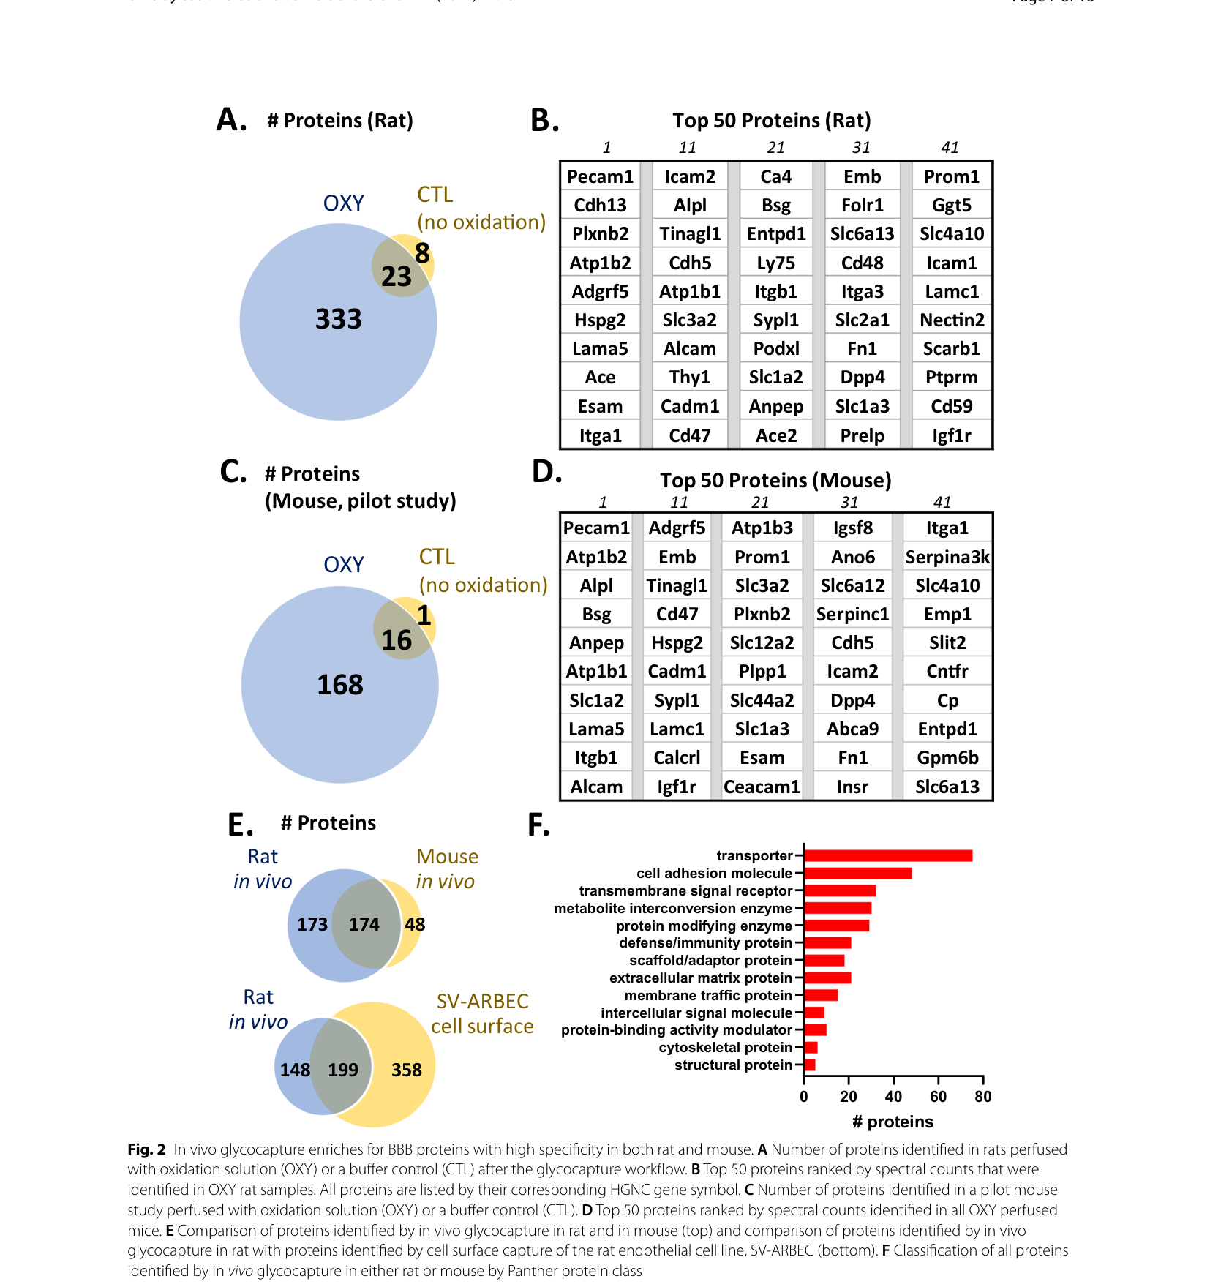
Results: Identification & Specificity
Identified: 347 proteins in Rat and 224 in Mouse.
High Specificity: 90% are predicted cell surface proteins.
Classification: Includes 73 transporters, 47 cell adhesion molecules, 31 receptors.
Validation: High overlap (57%) with rat endothelial cell line (SV-ARBEC).

Slide 6
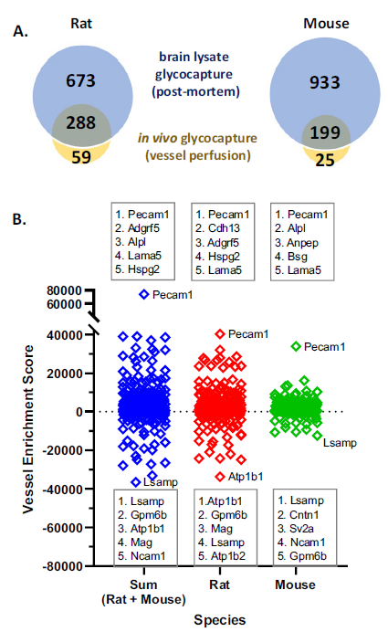
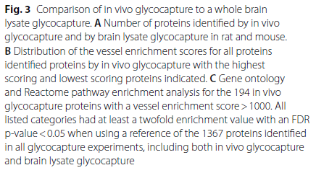
Vessel Enrichment (VE) Score
Definition: VE Score = CPM (In Vivo) - CPM (Whole Brain Lysate).
Interpretation: High VE Score indicates true luminal enrichment.
Top hits: Pecam1, Anpep, Bsg (Known markers).
Low hits: Neuronal proteins (Lsamp, Ncam1).
Conclusion: Validates the specificity of the perfusion method.

Slide 7
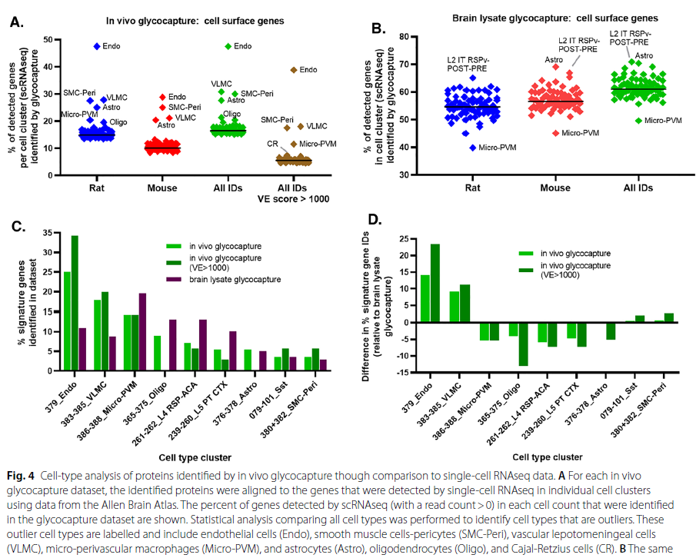
scRNAseq Validation
Method: Proteins were mapped to Allen Brain Atlas scRNAseq clusters.
Result: Highest match with Endothelial cells (Endo).
Coverage: Nearly 50% of endothelial surface genes were detected.
Nuance: Outliers included Pericytes and VLMC, suggesting NVU specificity.

Slide 8
Identified RMT Targets
Known Carriers Found: Transferrin Receptor (Tfrc), Insulin Receptor (Insr), IGF1R, Basigin (Bsg).
Potential New Targets (High VE Score): Anpep (CD13), Esam, Icam2, Alpl (TNAP).

Slide 9
Conclusion
Summary: In vivo glycocapture provides the most specific profile of the luminal BBB to date.
Comparison: Identified >2x more proteins than previous biotinylation methods.
Utility: Provides a curated list of accessible targets for brain delivery (RMT).
Mechanism: Demonstrates that the glycocalyx was likely the barrier for previous methods.
Relevance: Identifies accessible surface targets for Antibody Engineering and AAV Capsid display.

